Slide 1
ELECTRICAL SCIENCE-1 (15B11EC111) UNIT-3 Lecture-2
Dr. Abhishek Kashyap
Assistant Professor (Senior Grade, JIIT Noida)

Slide 2
Topics to be discussed
Basics of Thevenin’s theorem.
Finding the Thevenin's equivalent circuit.
Procedure for solving a circuit using Thevenin’s Theorem
Problems.
Practice Problems
References

Slide 3
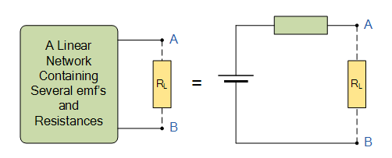
Thevenin’s Theorem
M. L. Thevenin, a French engineer, introduced the Thevenin theorem and its equivalent circuit in 1883.
Statement: Thevenin’s Theorem states that “Any linear circuit containing several independent or dependent voltages sources and resistances can be replaced by just one single voltage in series with a single resistance connected across the load”. In other words, it is possible to simplify any electrical circuit, no matter how complex, to an equivalent two-terminal circuit with just a single constant voltage source known as Thevenin’s equivalent voltage (Vth) or open circuit voltage (Voc) in series with a resistance or impedance (Thevenin’s equivalent resistance, Rth)) connected to a load as shown below.
Rth
Vth or Voc
Fig. 1 (a)
Fig. 1 (b)

Slide 4
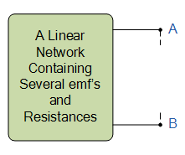
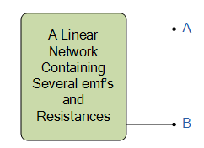
Finding the Thevenin equivalent circuit
Thevenin equivalent voltage Vth or Open circuit voltage , Voc : In Fig. 2, an open circuit is connected across the terminals A – B of circuit shown in Fig. 1(a) or removing the load resistance R_{L} from A - B terminals. The voltage across that open circuit is the open-circuit voltage, Voc.
Short circuit current, Isc: In Fig. 3, a short circuit is connected across the terminals A - B. The current in that short circuit is the short-circuit current, Isc.
+
Voc or Vth
-
Fig. 2
Isc
Fig. 3

Slide 5
Finding the Thevenin equivalent circuit
Thevenin equivalent resistance: Fig 4. indicates that Rth, is the thevenin equivalent resistance looking back into the circuit when all the independent voltage sources are replaced by short circuits and current sources by open circuits. However, dependent current and voltage sources are not replaced with open circuits or short circuits.
Thevenin resistance, Rth, can be determined by repeatedly replacing series or parallel resistors by equivalent resistors. Sometimes, a more formal method is required where, a current source having current I_{t}, is connected across the terminals of circuit and the voltage, V_{t}, across the current source is calculated or measured.
Then Thevenin equivalent resistance can be calculated as
Rth
Fig. 4

Slide 6
Procedure for solving a circuit using Thevenin’s Theorem
Remove the load resistor R_{L} or component concerned.
Find R_{th} by shorting all voltage sources or by open circuiting all the current sources.
Find V_{oc} by the usual circuit analysis methods.
Find the current flowing through the load resistor R_{L}.

Slide 7
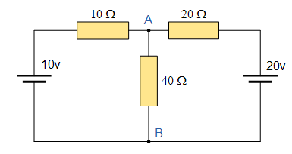
Problems
Q1. For the given circuit, calculate the current in 40 Ω resistor using Thevenin theorem.

Slide 8
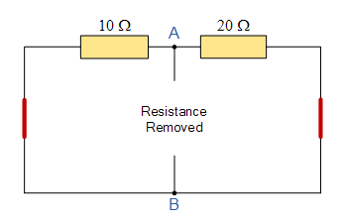
Problem1-Solution
Sol. Step 1: Calculate Rth

Slide 9
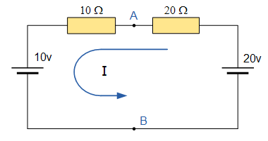
Problem 1 continues
Sol. Step 2: Calculate Vth

Slide 10
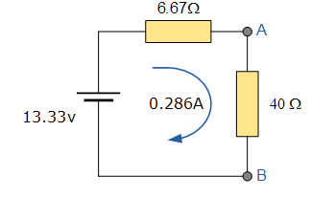
Problem 1 continues
Step 3: Calculate current across 40 Ω

Slide 11
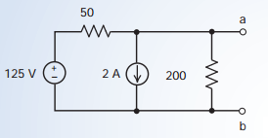
Problem 2
Q2. Determine the Thevenin equivalent circuit for the circuit shown in Figure.

Slide 12
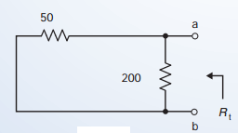
Problem 2
Sol. Step 1: Calculate Rth

Slide 13
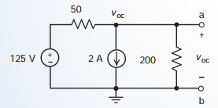
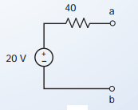
Problem 2 continues
Sol. Step 2: Calculate Vth
Step 3: Thevenin equivalent circuit

Slide 14
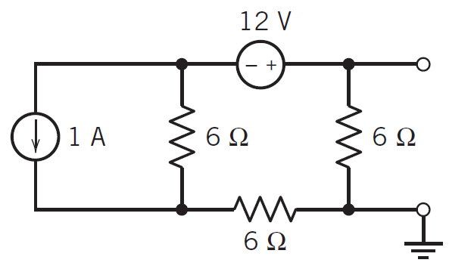
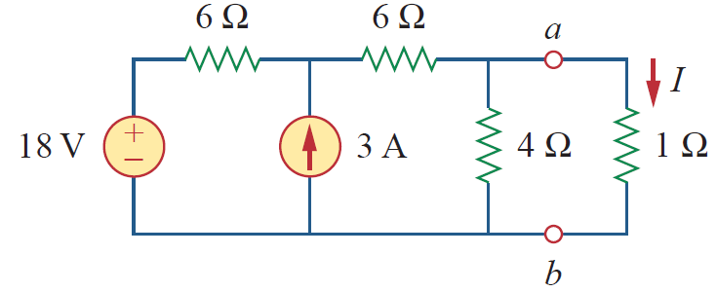
Practice Problems
Q1. Determine the Thevenin equivalent network for the following circuit.
Ans. V_{th} = 2V, R_{th} = 4Ω
Q2. Calculate the value of I, using Thevenin theorem. Also find Thevenin equivalent network
Answer: V_{Th} = 9 V, R_{Th} = 3 Ω, I = 2.25 A.

Slide 15
References
[1]R.C. Dorf and James A. Svoboda, “Introduction to Electric Circuits”, 9th ed, John Wiley & Sons, 2013.

